Slide 1
Social Media Data Analysis SQL project

Slide 2
Project Overview: Social Media Data Analysis
This data analysis project is centred around a social media platform's database like Instagram. The dataset contains information about users, their interactions with content basically photos and videos and the content itself. It includes details such as user profiles, posts, comments, likes, and tags associated with the content.
This project delves into the social media platform's data to uncover valuable insights that can drive improvements in user engagement, content quality, and overall platform success

Slide 3

Project Objective:
To analyse a social media platform's database to provide specific insights into user engagement patterns, content effectiveness, and user behaviour. The primary aim is to identify actionable recommendations for increasing user retention, optimizing content strategies, and enhancing the overall user experience.
This objective emphasizes on the specific aspects of the analysis like
user engagement, content effectiveness, and user behaviour
the project aims to provide recommendations for enhancing
user retention, optimizing content strategies, and making
informed decisions to benefit both users and
the platform's growth

Slide 4
Unlocking Insights: Data Analysis of a Social Media Platform
User Activity:
The first 10 users on the platform , the most loyal user .
The day of the week most users register on, potential ad campaign day.
The percentage of users who neither comment nor like on any content.
Number of users who never post any content .
most engage users , who likes and comments most
Security and suspicious account :
1. find out the users who like or comment on each and every content .
3. Followers and following behaviours :
1.Which users have the most followers? Who are they following?
3.Post Analytics:
What are the most popular hashtags used in posts?
What is the average number of likes and comments per post?
The users who have never posted a photo
The number of photos posted by most active users
6. Who are the top 10 users with the highest number of likes on their posts?
7.What is the average number of posts per user?

Slide 5
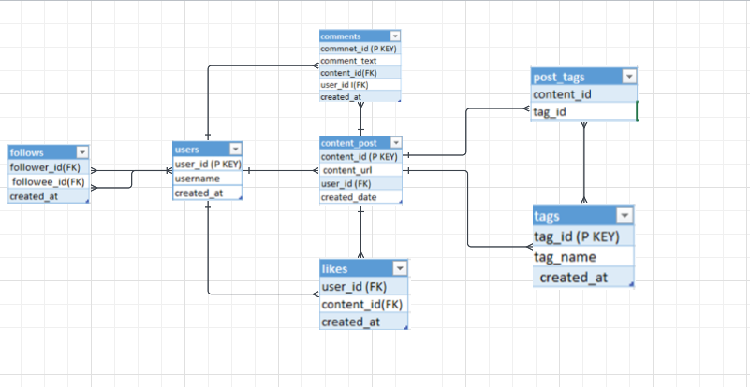
Entity –Relation Diagram of the database :

Slide 6
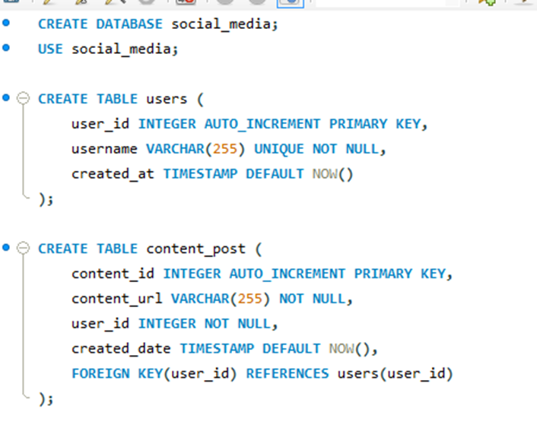
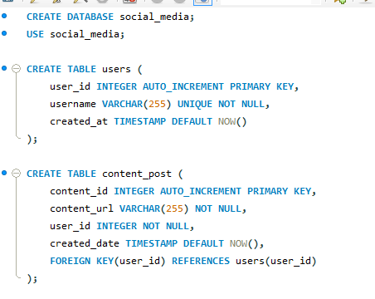
Create Table in database and Schema:
Create Database :
Create Table users :
Create Table content_post :

Slide 7
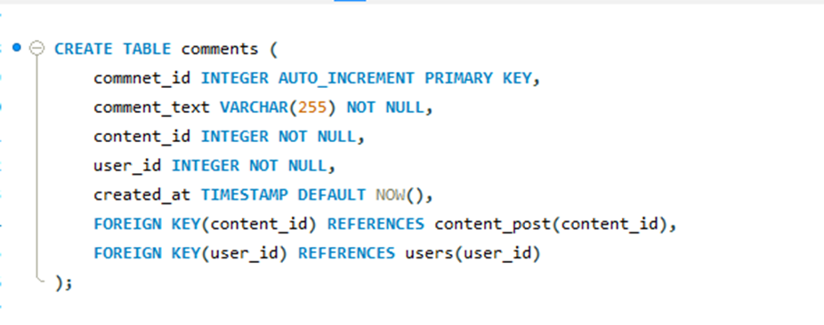
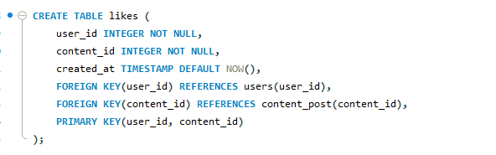
Create Table in database and Schema:
Create Table comments :
Create Table likes:

Slide 8
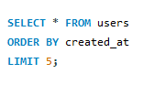
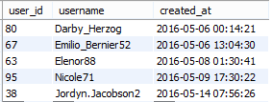
1. reward some user’s who have been with us for long period of time : Recognizing and rewarding long-term customers can enhance their loyalty to your platform.

Slide 9
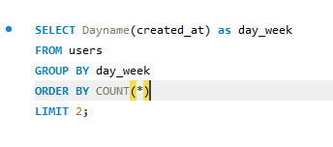

2. The day of the week most users register on, potential ad campaign day : If you run social media platform, consider launching ad campaigns on the day when most users register and on the days leading up to it.

Slide 10


3. What is the average number of posts per user?

Slide 11
3. What is the average number of posts per user?

Slide 12
4. The percentage of users who neither comment nor like on any content.

